Slide 1
Data analysis Synopsis
Here we will be Exploring Key Metrics like Queue Performance, Revenue and Sales to uncover trends, patterns, and potential areas of improvement for the Business Concerned.
The aim is to equip us with actionable insights, empowering informed and strategic decision-making.

Slide 2
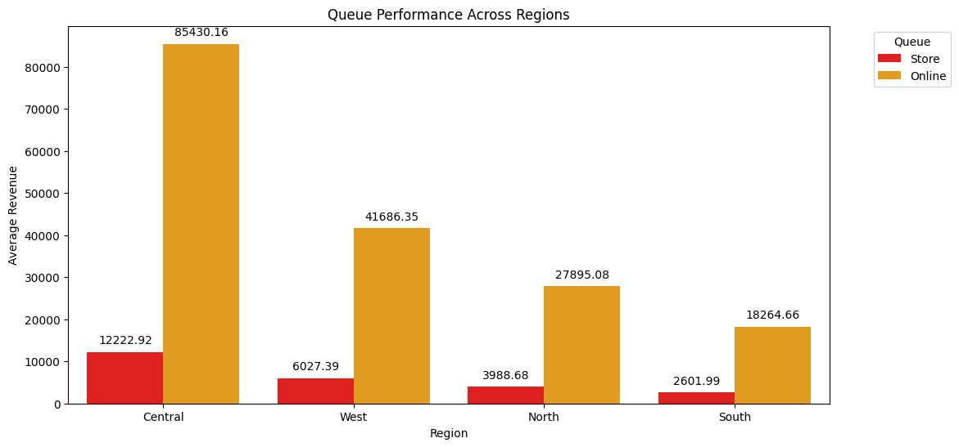
Queue Performance
Online queue performance consistently outshines store queues across all regions, indicating a broader trend favoring online platforms.
Central region stands out as a powerhouse, excelling in both online queue efficiency and generating the highest average revenue among all regions.
Southern region faces challenges with the lowest average revenue.
Regional revenue disparities is evident across all queue platforms
REVENUE BY YEAR

Slide 3
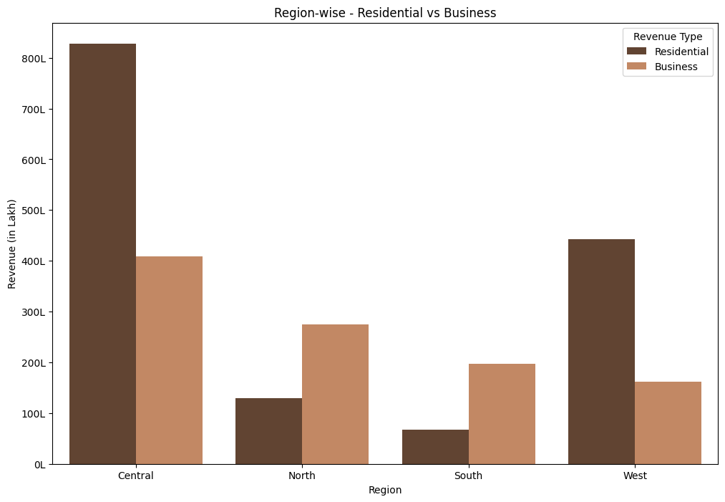
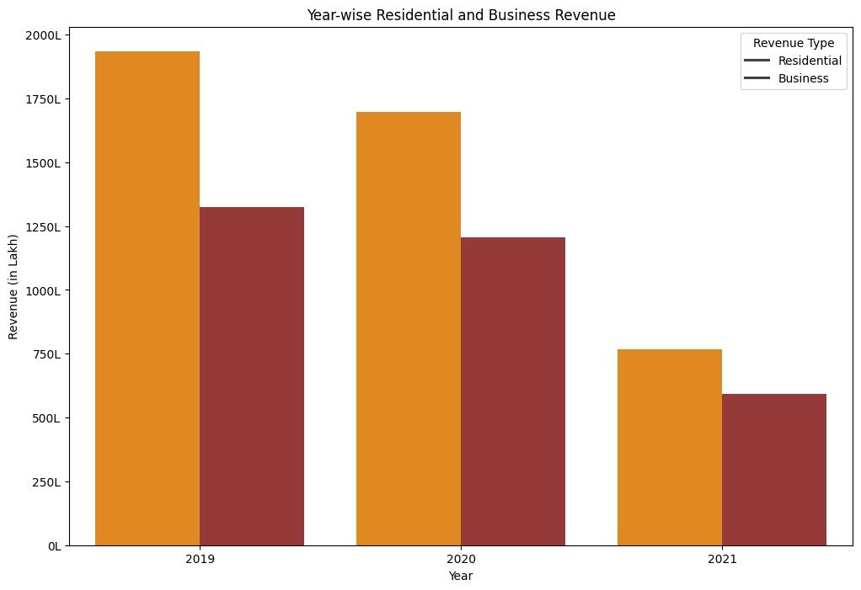
Revenue Trends – Residential vs Business

Slide 4
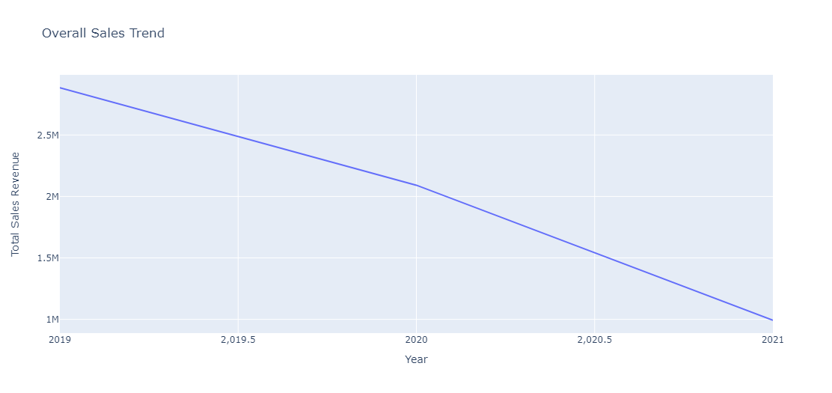
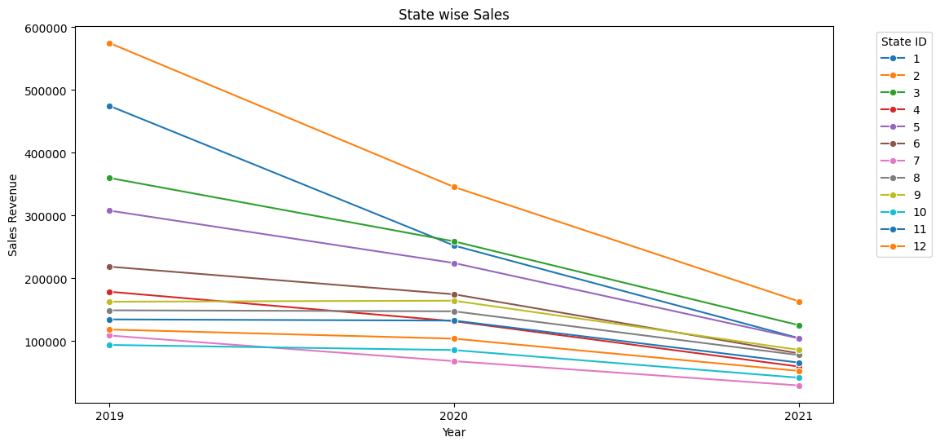
Sales Trend
Consistent Overall Sales Decline (2019-2020)
Steep Decline since 2020
Stable Sales in Most States (2019-2020): However, Jharkhand and Odisha in the Central region stood out with noticeable fluctuations
Linear Sales Decline in Central Region (2020): In 2020, a decline in sales was observed across all states ,especially a linear decline in the Central region

Slide 5
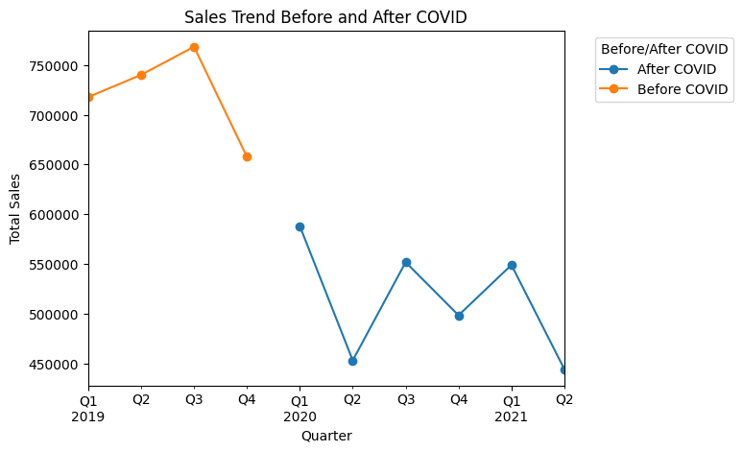
Sales Trend Pre & Post Covid
Q3 2019 witnessed robust sales exceeding 75,0000, but a subsequent decline signaled changing market dynamics before COVID-19.
COVID-19 Impact: January 2020 marked a sharp drop in sales to below 45,0000, reflecting the immediate impact of the pandemic on consumer behavior and economic conditions.
Post-COVID, sales have stabilized within a consistent range, occasionally peaking around 55,0000, indicating resilience but not a return to pre-pandemic levels.
REVENUE BY YEAR

Slide 6
Recommendations
The Central Success Story:We have seen great success in the Central region. Make our products more accessible, form stronger connections with our customers, and consider opportunities for growth in the heart of our success.
Southern Market Revival: Understand Southern market needs and Customize our approach
Adapt After 2019:Adjust strategies post-2019, Brainstorm new product ideas, and Enhance customer experience.
Explore New Horizons: To stay vibrant and growing, let's diversify our offerings. Embrace innovation and Keep an eye on possibilities.

